Slide 1

Audience Measurement and Sentimental Analysis
Presented by - Yogesh Deshpande
Akshay Bhogan
Viren Baria
Project Mentor – Prof. Sunil Karamchandani

Slide 2
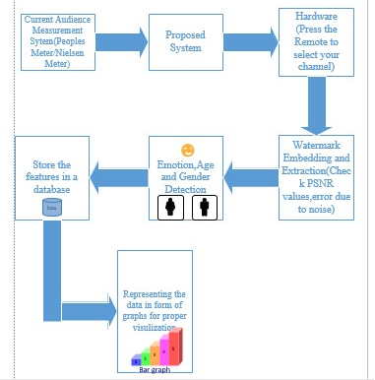
Advanced Bar-O-meter or People’s Meter
A smart system which measures the television audience as well as provides valuable insights about the viewers to the channel providers.
About the product

Slide 3
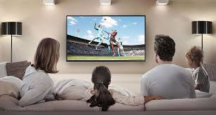
Product Features
Advanced Bar-O-meter or People’s meter
Check the authenticity of the channels
Total viewers watching the channel/program
Viewer’s demographic information like-
Total members in a family
Gender
Age
Emotion

Slide 4

Part 1: Authentication of the channels
Digital Video Watermarking the channel provider content with hidden watermark and extracting it to check its authenticity and report malicious activities.

Slide 5
Digital Watermarking
The embedding of data like watermark and digital signature into digital media like image, audio and video, such that when that data is extracted or detected, it can be used for determining the originality of the data. This process is called as watermarking or digital watermarking.
Reason of watermarking
DWT
The main reason why digital watermarking is popular is because it provides copyright protection, which prevents illegal copying and circulation of video. Under copyright protection, the data such ownership information and logo of the digital media is authenticated, without degrading the quality of the content. To prove the correct ownership the data is extracted and used as authoritative proof.
In this method, the original carrier image is average split into four parts. For each part, the DWT and DCT transforms are successively applied, and the first two alternating current (AC) coefficients are used to form a new matrix. Finally, the watermark is embedded into this new matrix using an SVD-based watermarking method. Since these four parts are all embedded by the same watermark, this method has a high robustness to cropping operations.

Slide 6
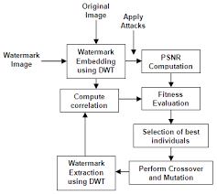
Evaluating the robustness of the watermarking
The robustness of the video watermarking is proven by extraction of the watermark after exposing the video feed to certain attacks. Some of these attacks are gaussian noise, salt and pepper noise, cropping, histogram equalization, sharpening filter and intensity adjustment. The typical values for the PSNR in video watermarking are between 60 and 80 db.
Attacks | Noise Factor | PSNR
Gaussian noise | 0.9977 | 65.88
Salt & Pepper noise | 0.9972 | 69.4819
Cropping | 0.9987 | 37.3145
Histogram equalization | 0.9980 | 49.0789
Sharpening filter | 0.9983 | 71.3505
Intensity adjustment | 0.9982 | 68.2943

Slide 7

Part 2: Viewer’s Demographic Data Collection
The smart meter consists of a camera which captures the viewers in front of the television. This captured frames are passed through the recognition software that detects gender, age and emotion of the viewer.

Slide 8
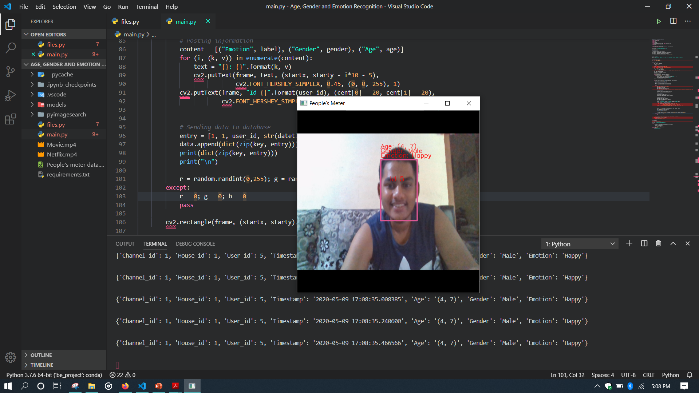
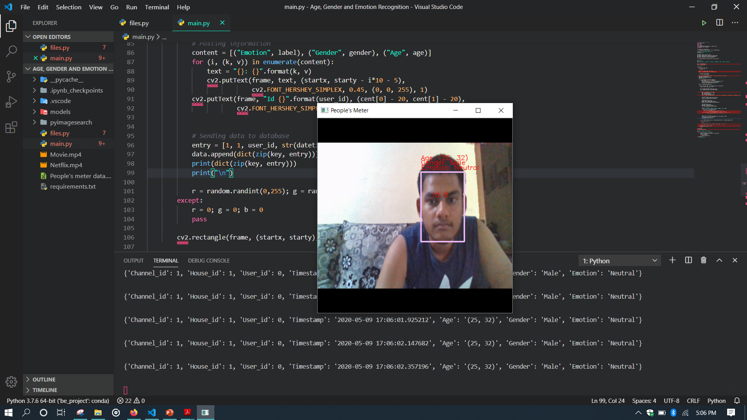
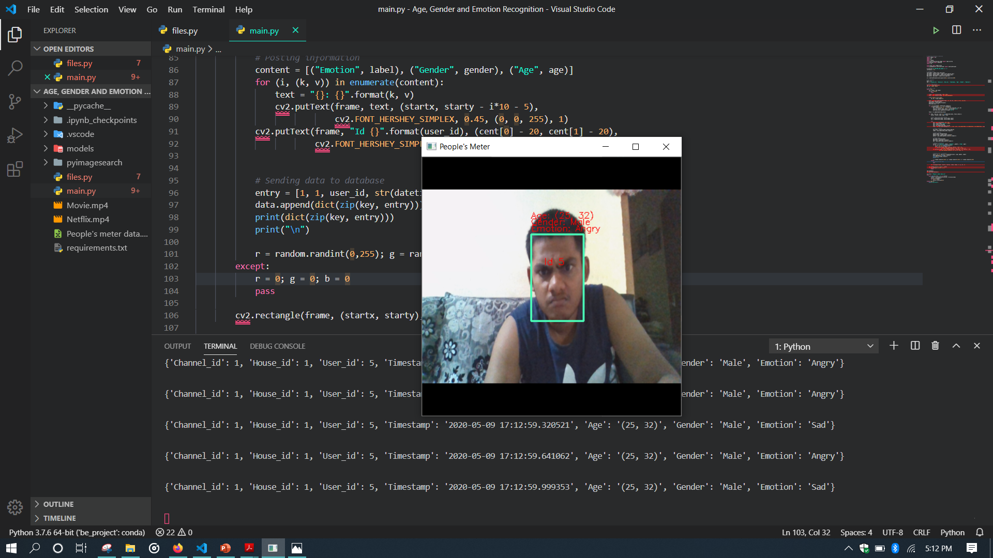
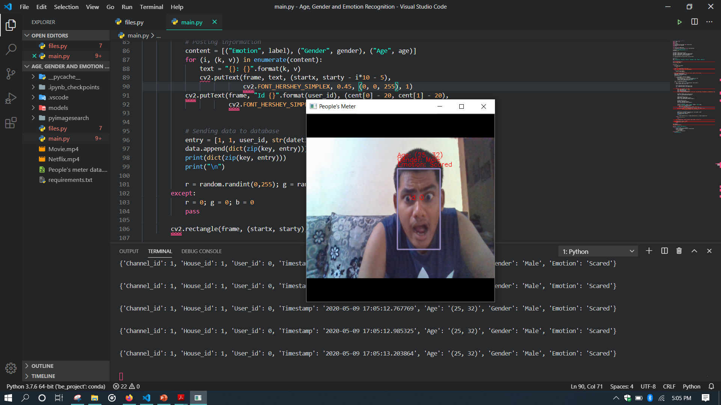
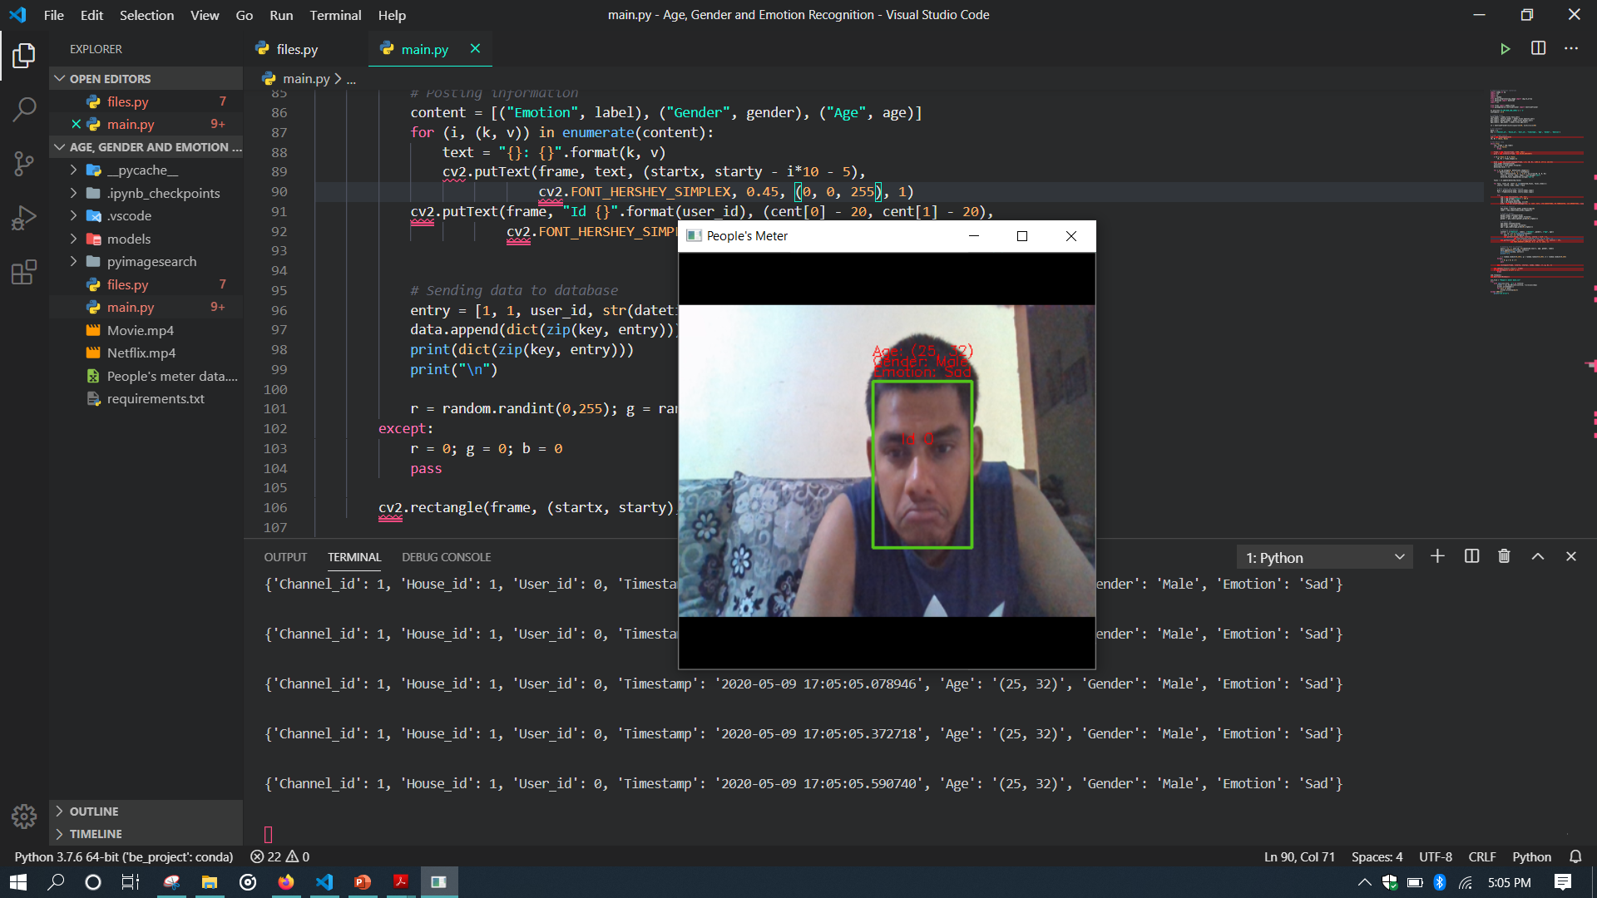
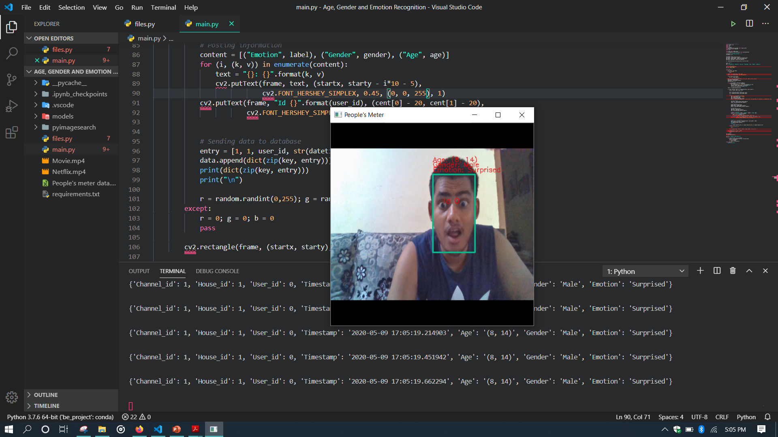
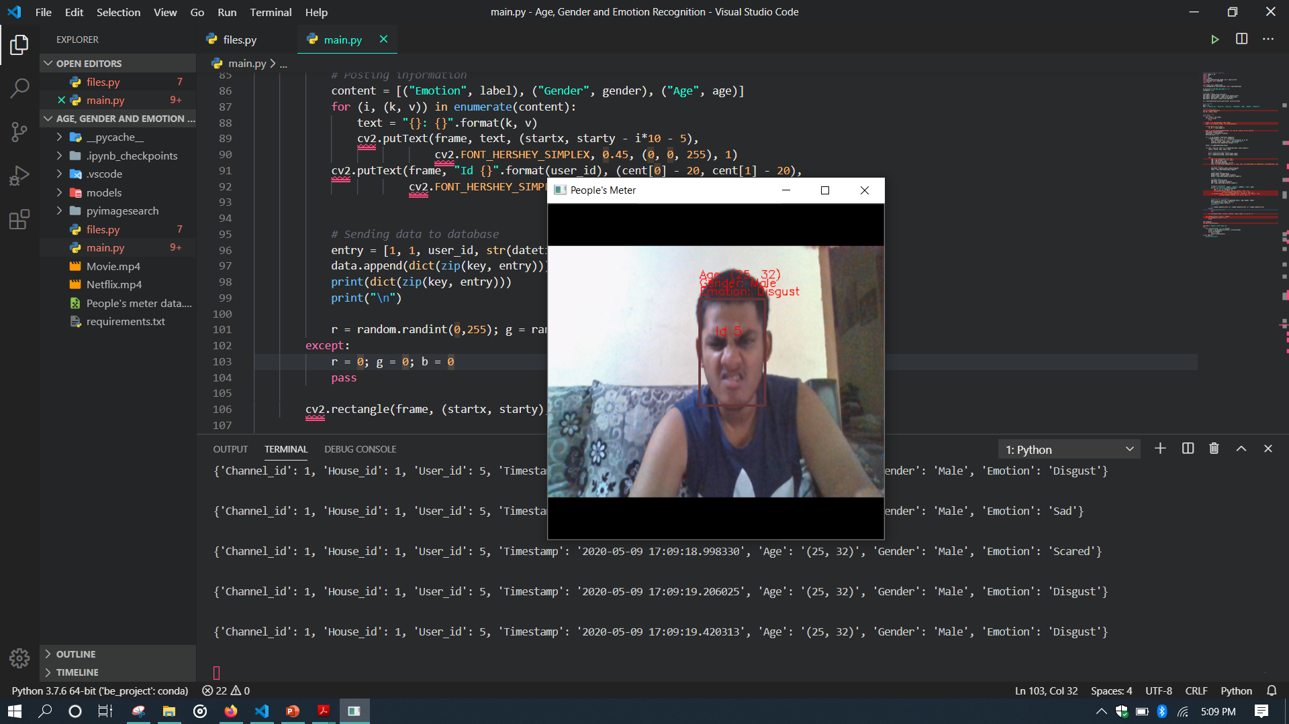
Recognition Samples

Slide 9
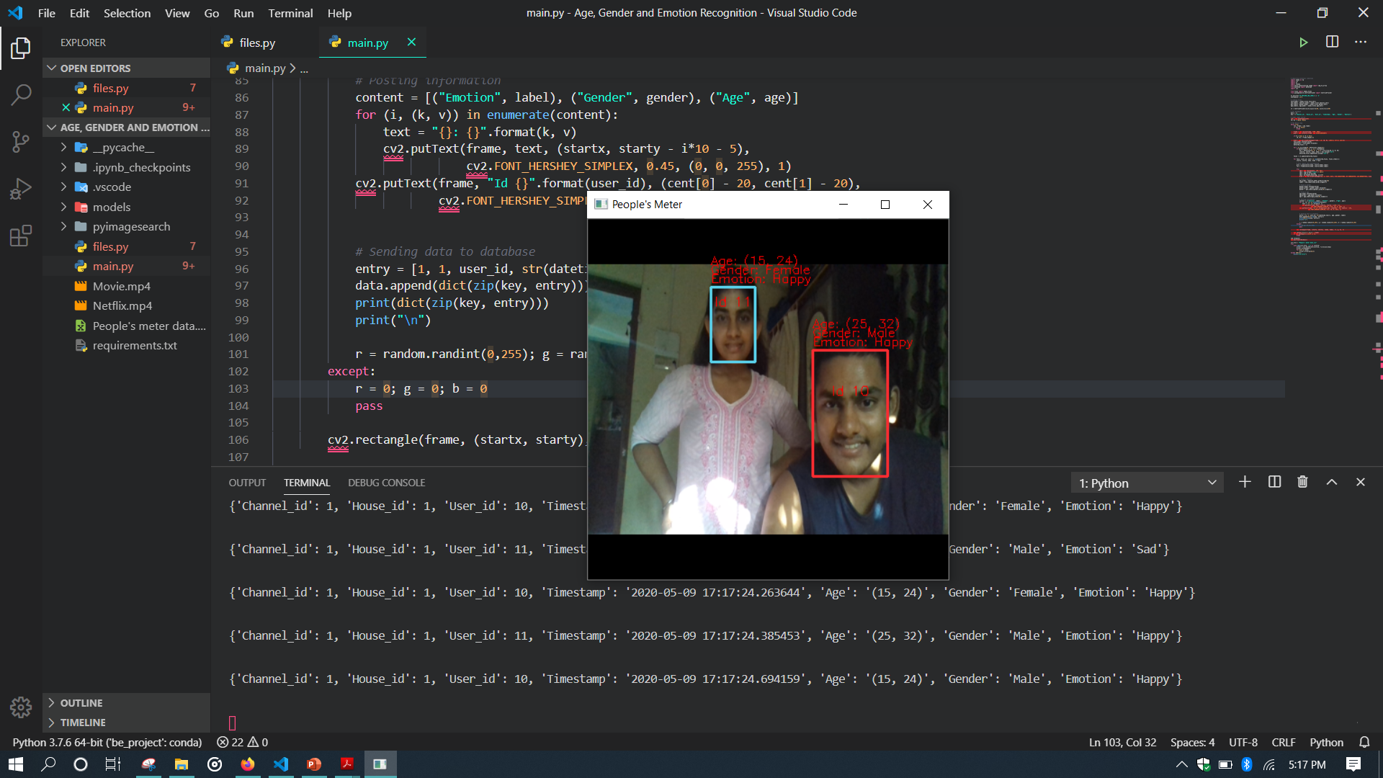
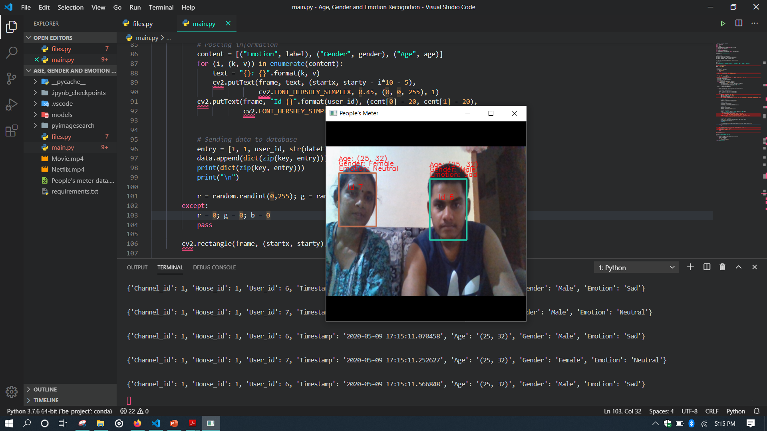
Recognition Samples (Multiple Viewers)

Slide 10
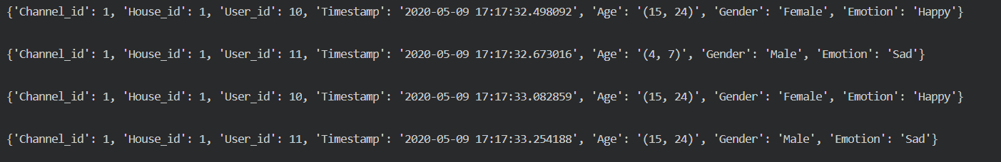
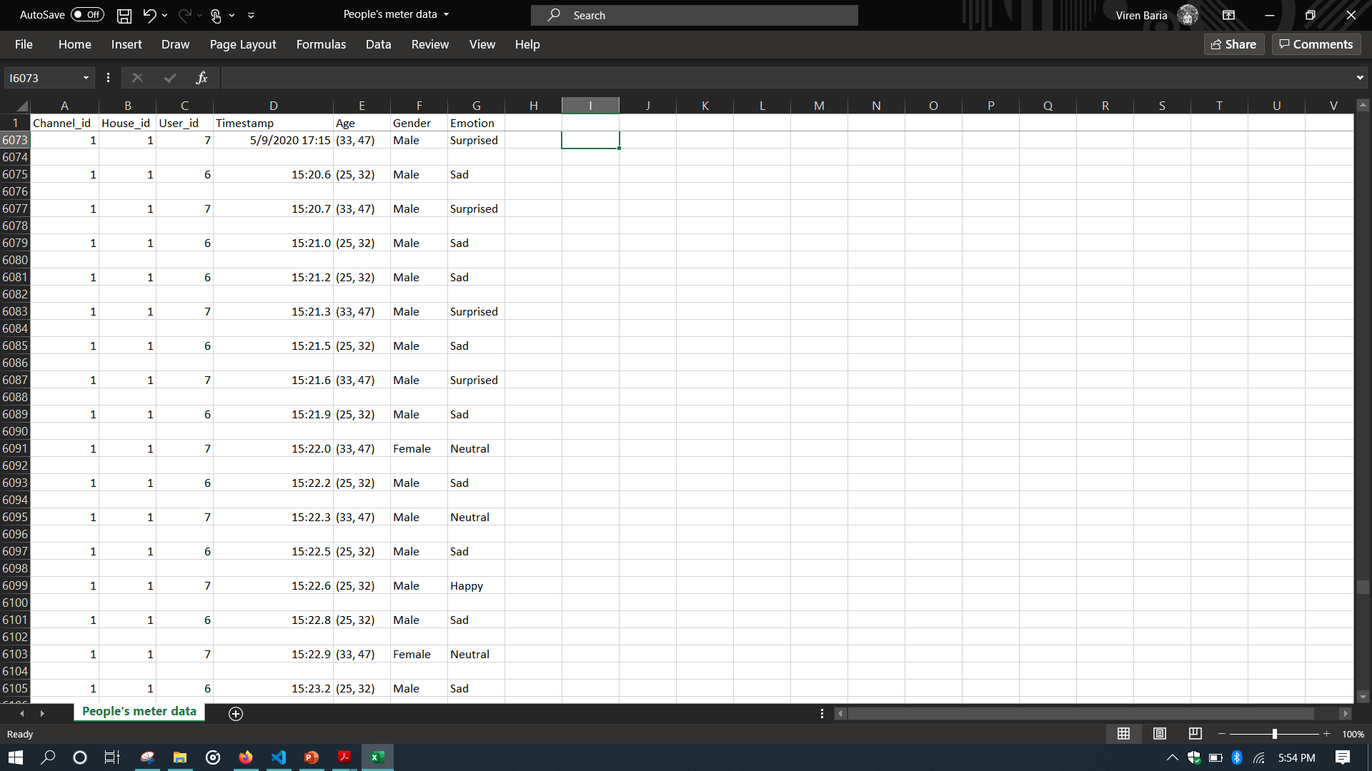
Data Collection
Data dictionaries are created for each frames, which can also be used to push in database.
People’s meter data.csv
A .csv file containing the demographic data

Slide 11
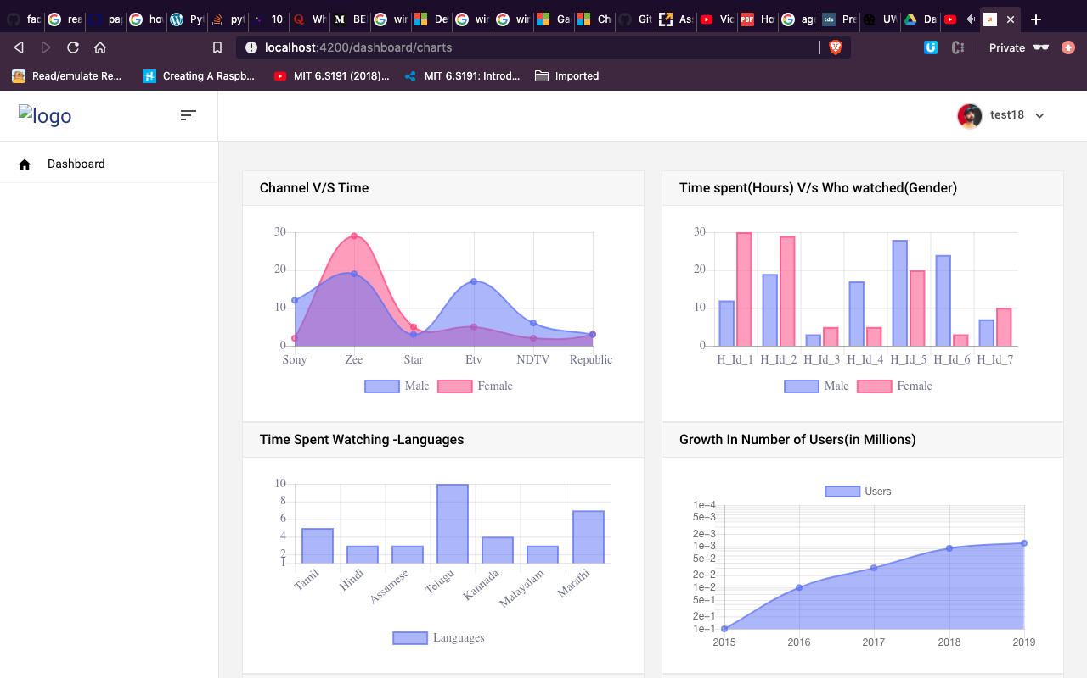
Data Visualization
A website running on the local server, where the measurement authority can login and check the visualizations.

Slide 12
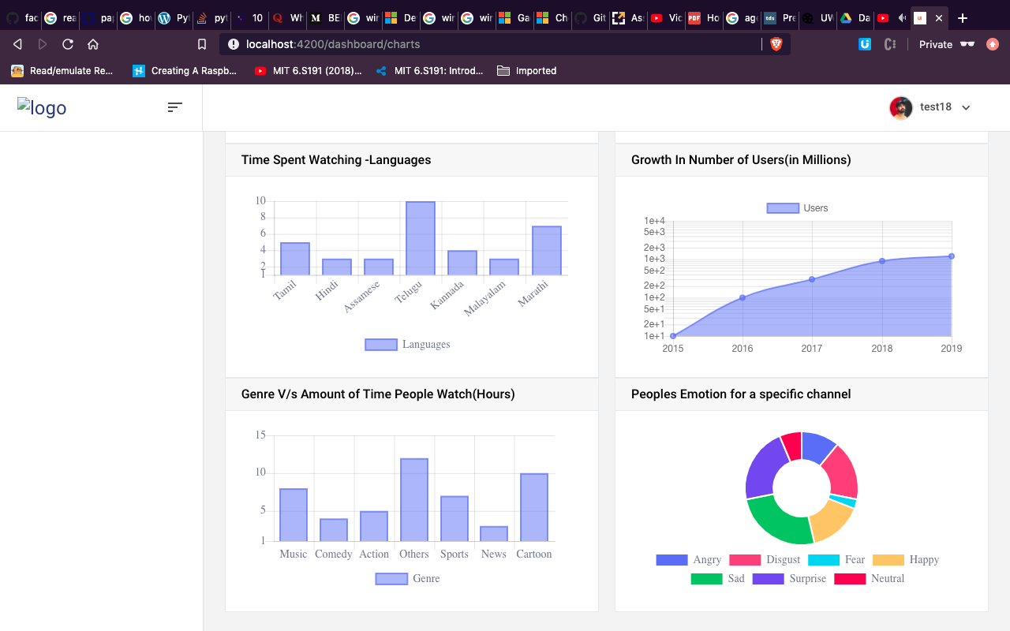
Data Visualization
A website running on the local server, where the measurement authority can login and check the visualizations.

Slide 13
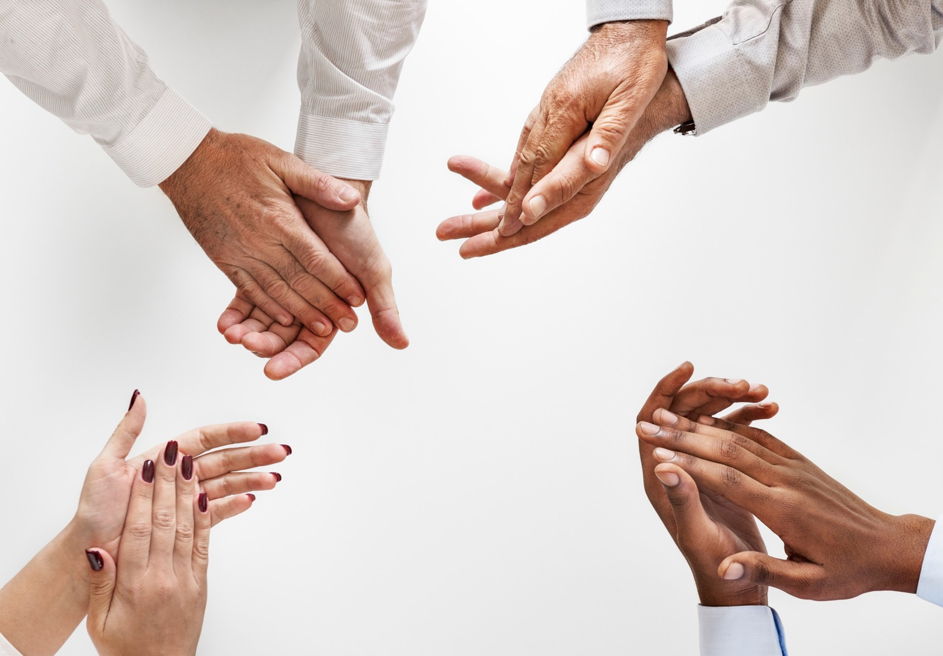
Thank You

